Slide 1
Project Title : Password Generator
Name and Roll No: Ayushi
2210990206

Slide 2
Index
Objective
Introduction
Methodology, Approach & Techniques
Algorithm
Result
Source Code (screenshots)
Conclusion
Reference

Slide 3
Objective
A password generator is a tool or program designed to create strong, random passwords. These passwords are typically difficult to guess and provide better security for accounts and sensitive information.

Slide 4
Introduction
It is a Password Generator project using Python programing language.
its ability to create strong and unique passwords automatically. This reduces the likelihood of users choosing weak or easily guessable passwords, thereby enhancing the security of their accounts and sensitive information.
Tools: Python, Math library,random library

Slide 5
Methodology, Approach & Techniques
1. The code utilizes the random.choice() function to select characters randomly from the specified character sets. This ensures that the generated passwords are truly random and not predictable.
2. After generating characters for the password, the code shuffles the characters using random.shuffle().
The approach focuses on dividing the password into different parts (alphabetic, numeric, and special characters), generating random characters for each part based on the specified lengths, and then combining these characters to form a strong and random password.

Slide 6
Algorithm
Input Prompt
Character Set Definition
Password Length Allocation
Random Password Generation
Password Concatenation
Output

Slide 7
Result
The result of password generator code is the generation of a random password based on the user's specified length. The password is printed to the console for the user to see.

Slide 8
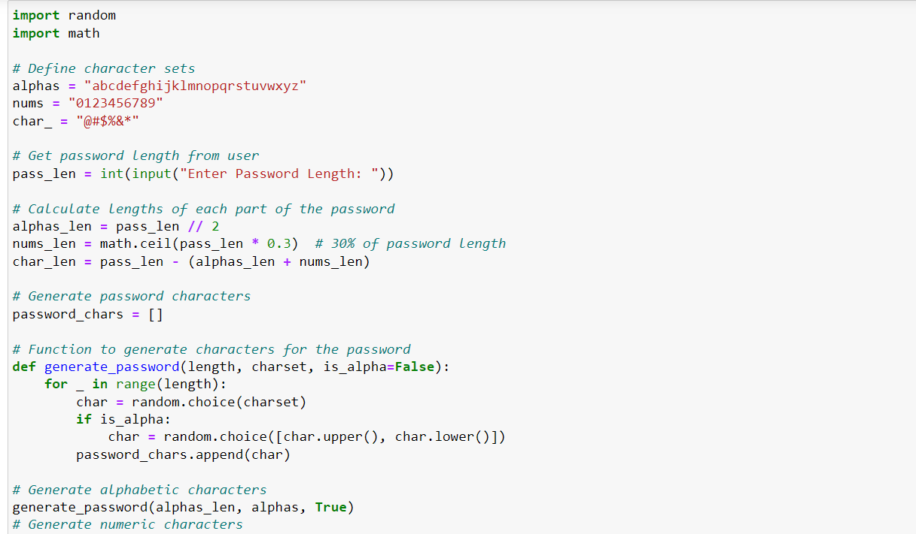
Source Code (screenshots)

Slide 9
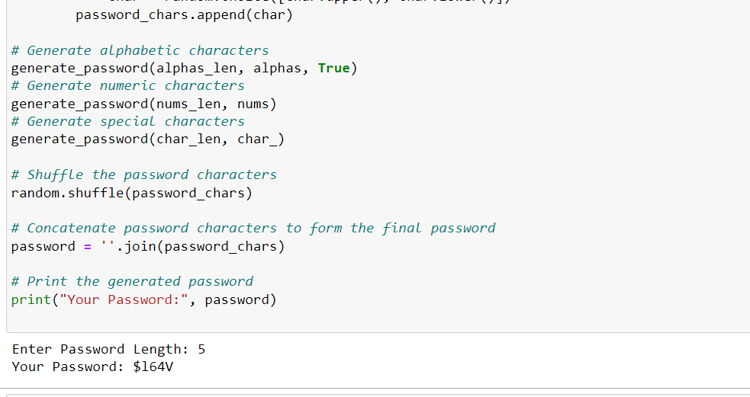

Slide 10
Reference
GeeksForGeeks
Javapoint

Slide 11
The End

